Slide 1
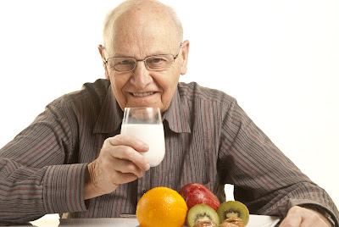
Dairy Nutrition for Healthy Aging: Research and Practice
Tanya M. Holloway, PhD
Exercise Metabolism Research Group
McMaster University
Hamilton, On, Canada

Slide 2
Meet Bob…..
64 years old
Annually Bob loses ~1% of his muscle mass and ~3% of his muscle strength
Increases his risk of many common medical problems-including his risk of mortality

Slide 3
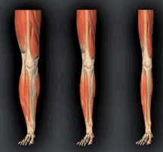
“Sarcopenia”
Loss of strength, function
Sarcopenia has been defined as an age-related continuous decline in muscle mass, quality, and strength
It is characterized by overall decreases in size and number of skeletal muscle fibers, and a infiltration of fibrous and fatty tissue into the skeletal muscle

Slide 4
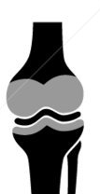
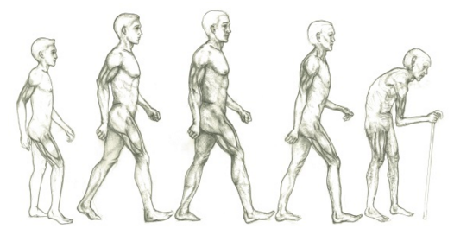
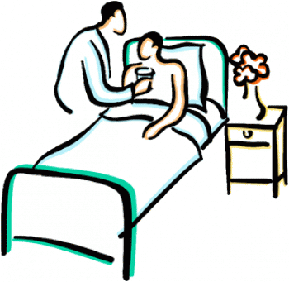
Time Course of Sarcopenia
Muscle mass 1%/yr
Muscle strength 3%/yr
Percent of Total (%)
50
Age (years)
80
English and Paddon-Jones (2010)Curr Opin Nutr Metab Care;13,34-39

Slide 5
Recommended Daily Amount for Protein
In Canada and the US the recommended dietary allowance defines the RDA (0.8-0.9g protein/kg/day) as’…the average daily intake level sufficient to meet the nutrient requirement of nearly all [98%] healthy individuals….’

Slide 6
Minimal vs. Optimal Protein
Minimal (RDA)
80kg, 62year old man
80 x 0.8 = 64g
3 meals:
  Breakfast – 9g
  Lunch – 18g
  Dinner – 37g
Requires 2700 kcal
260/2700 = 9.5%

Slide 7
Strategies…..
Quantity matters…..older adults need more protein to stimulate synthesis
Timing matters……older adults need protein more often for positive protein balance
Quality matters……leucine rich protein sources are superior in stimulating protein synthesis
Notes:
predisposing factor for morbidity and mortality, but can be offset with exercise and protein
affected by protein ingestion and loading
than currently ‘recommended’ in the elderly

Slide 8
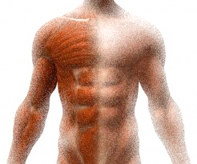
Variations in protein synthesis determine net protein balance
How is Muscle Mass Regulated?
MPS
MPB
Rate of MPS and MPB
protein
protein
protein
Time (h)
T.A. Churward-Venne, N.A. Burd, and S.M. Phillips. Nutr. Metab. 9(1): 40, 2012.

Slide 9
Anabolic Resistance of Muscle Protein
MPS
MPB
Rate of MPS and MPB
protein
protein
protein
Time (h)
© Tanya Holloway PhD

Slide 10
Protein Requirement in Young vs. Old
Older = 0.40 g/kg
Young = 0.24 g/kg
Moore et al. J. Gerontol. A Biol. Sci. Med. Sci. 70(1): 57-62, 2015

Slide 11

Seniors Consuming Higher Protein
Adjusted lean mass (LM) loss by quintile of energy-adjusted total protein intake. n = 2066.
©2008 by American Society for Nutrition
Houston D K et al. Am J Clin Nutr 2008;87:150-155
Notes:
Smaller loss of LBM over 3 years in \
Increased protein intake results in less loss of lean mass over a 3 year period

Slide 12
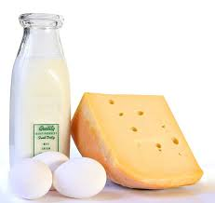
Older persons require larger doses of protein to stimulate MPS

Slide 13
New Recommendations from International Expert Groups Call for Higher Protein Intake* in Older Adults
Up to 2.0g/kg
Severe illness or injury,
or marked malnutrition²
1.0-1.2g/kg
Minimum protein intake for healthy people^{2,3}
1.2-1.5g/kg
Acute or chronic
disease^{2,3}
0.8g/kg
RDA
(19+yrs)¹
Current¹
New Recommendations >65 years^{2,3†}
*increase above current Protein RDA¹
†Older people with severe kidney disease who are not on dialysis may need to limit protein intake.
1.DRIs for Energy, Carbohydrate, Fiber, Fat, Fatty Acids, Cholesterol, Protein, and Amino Acids (Macronutrients). (2005) National Academy of Sciences. Institute of Medicine. 2. Bauer J et al. Evidence-based Recommendations for Optimal Dietary Protein Intake in Older People: A Position Paper From the PROT-AGE Study Group. JAMDA. 2013;14:542-59. 3.Deutz NEP et al. Protein intake and exercise for optimal muscle function with aging: Recommendations for the ESPEN Expert Group. Clinical Nutrition (2014)

Slide 14
Strategies…..
Quantity matters…..older adults need more protein to stimulate synthesis
Timing matters……older adults need protein more often for positive protein balance
Notes:
predisposing factor for morbidity and mortality, but can be offset with exercise and protein
affected by protein ingestion and loading
than currently ‘recommended’ in the elderly

Slide 15
Skewed Protein Intake in Older Adults
Suboptimal
~30g
16-22g
10-15g
*Missed opportunities!
Adapted from Paddon-Jones & Rasmussen (2009) Curr. Opin. Clin. Nutr. Metab. Care; 12, 86-90
Notes:
Institutionalized range ~18 at dinner
Importantly most studies only report per meal protein with no consideration of quality, so for ex since most breakfast protein comes from lower quality proteins like cereal grains potentially further compounding the problem of low pro intake

Slide 16
Balanced (and increased) Intake
1
Paddon-Jones & Rasmussen (2009)
¹Groen BBL Am J Physiol Endocrinol Met 2012
Notes:
Low quality proteins, so we may need more.

Slide 17

When are we in our longest period of muscle loss?
While we are sleeping…

Slide 18
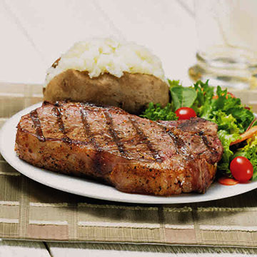
Older persons require larger doses of protein to stimulate MPS on a per meal basis than recommended

Slide 19
Strategies…..
Quantity matters…..older adults need more protein to stimulate synthesis
Timing matters……older adults need protein more often for positive protein balance
Quality matters……leucine rich protein sources are superior in stimulating protein synthesis
Notes:
predisposing factor for morbidity and mortality, but can be offset with exercise and protein
affected by protein ingestion and loading
than currently ‘recommended’ in the elderly

Slide 20
Source of Protein Matters
*
Tang et al. J. Appl. Physiol; 2009
Notes:
Young, 10g of EAA, 3h capture; spelling mistake; stats.

Slide 21
Leucine as a Nutraceutical
Devries- Aboud et al.

Slide 22
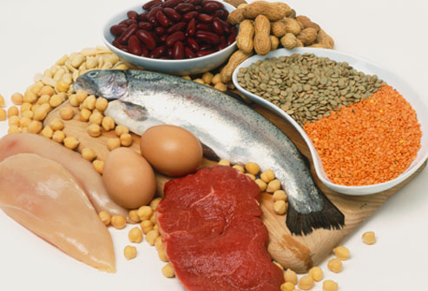
Nutrient-dense Foods
Milk and Dairy products*
Lean meats and Poultry*
Eggs*
Seafood*
  Beans and Peas (legumes)
  Vegetables and Fruits
  Whole grain foods
  Nuts and Seeds
* Good – Excellent sources of protein and amongst the top 10 protein-containing foods (NHANES 2007-2010) currently consumed by Americans

Slide 23
LEUCINE
Good sources of leucine include:
  Meat, poultry, fish
  Legumes
  Dairy products
Aim for 3-5 g of leucine per serving
3 times per day
Meat Chicken/pork Canned tuna | 4.0 g 3.5 g 3.5 g | Per 5 oz Per cup Per cup
Soybeans White and Kidney Lentils | 3.6 g 3.7 g 3.4 g | Per cup Per cup Per cup
Cow’s milk Cheese Yogurt | 0.8 g 0.5-1.0 g 1.0 g | Per cup Per 1 oz Per 6 oz

Slide 24
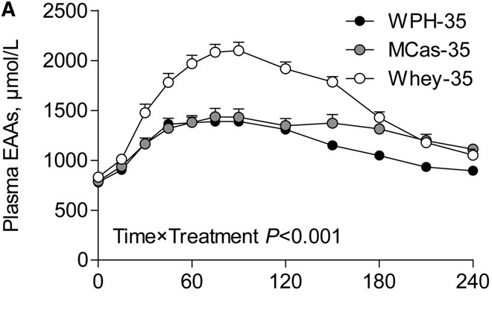
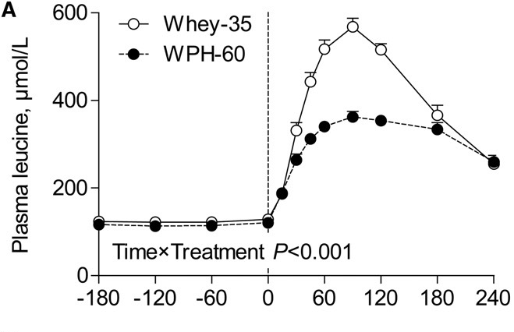
Plant vs. Animal Sources of Protein
WPH-Wheat protein
MCas-Casein
35 WPH vs. 35 Whey
60 WPH vs. 35 Whey
Gorissen J. Nutr 2016

Slide 25
Soy vs. Whey in the Elderly
Soy- ingestion of 20 g and 40 g does not stimulate increased rates of MPS under resting conditions in the elderly
Even when combined with resistance exercise, 40 g but not 20 g, of soy protein isolate has a modest effect on MPS
Whey- 20 g effectively stimulated MPS at rest, while both 20 g and 40 g increased post-exercise MPS in a stepwise manner
Thus soy appears less effective than whey protein at promoting increases in MPS in the elderly
FSR=fractional synthesis rate
Yang et al. Nut and Met 2012
Notes:
The higher rates of leucine oxidation in S20 vs. W20 suggest that a greater proportion of the amino acids from soy protein were diverted towards oxidation, and were thus unavailable as substrate for protein synthesis.

Slide 26

The inclusion of high protein dairy does not diminish weight loss
HiDairyPro: - 4.3 kg
DairyPro: - 4.2 kg
Control: - 4.4 kg
55:30:15
<600mg Ca²⁺
55:30:15
~1100mg Ca²⁺
40:30:30
~1700mg Ca²⁺
Josse et al. J Nutr 2011
Notes:
To determine the effect of diets high or moderate in dietary protein (as dairy with calcium and vitamin D) along with a diet and exercise induced caloric deficit of 750 kcal/d on loss of fat mass and retention of lean mass in otherwise healthy young overweight and obese females

Slide 27
Minimal vs. Optimal
Minimal (RDA)
80kg, 62 year old man
80 x 0.8g/kg/day = 64g
3 meals:
  Breakfast – 9g
  Lunch – 18g
  Dinner – 37g
Requires 2700 kcal
260/2700 = 9.5%
“Optimal”
80kg, 62 year old man
1.2g/kg/day = 96g
4 meals x 0.2-0.4 g/kg/meal
  Breakfast – 16g
  Lunch – 32g
  Dinner – 32g
  Bedtime snack -16g
Requires 2700 kcal
384/2300 = 17%

Slide 28
Simple message..
Eat more protein
Eat it more often (spread evenly between meals)
Protein snack before sleep
Nutrient dense high quality protein is best (high leucine content)

Slide 29
To Summarize……
For healthy aging, older adults require:
  greater amounts of protein,
  protein more often,
  higher quality protein.

Slide 30
Principal Scientist
Prof. Stuart Phillips
Laboratory Manager
Mr. Todd Prior
Post Doctoral Researchers
Dr. Stefan Gorissen
Dr. Tanya Holloway
Dr. Martin MacInnis
Dr. Chris McGlory
Dr. Dan Traylor
Ph.D., Trainees
Ms. Amy Hector
Mrs. Kirsten Bell
Ms. Sara Oikawa
Mr. Rob Morton
Mr. Tanner Stokes
Ms. Josie Vescio
Protein Metabolism Research Group

